Slide 1
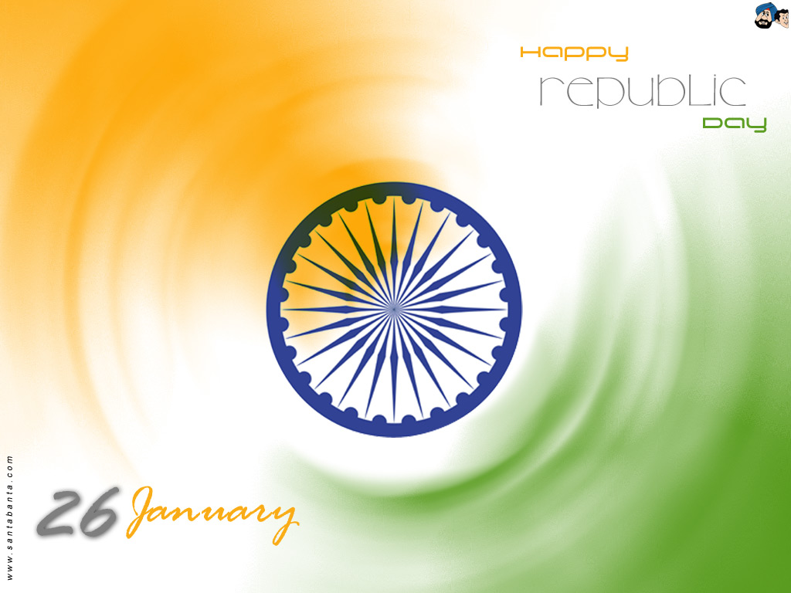
Republic Day of India

Slide 2
Why we celebrate Republic day
The Republic Day of India is a national holiday of India to mark the adoption of the Constitution of India and the transition of India from a British Dominion to a republic on January 26, 1950.
A republic is a form of government in which the head of state
is not a monarch and the people (or at least a part of its people) have an impact on its government.
The word 'republic' is derived from the Latin phrase res publica, which can be translated as "a public affair".

Slide 3
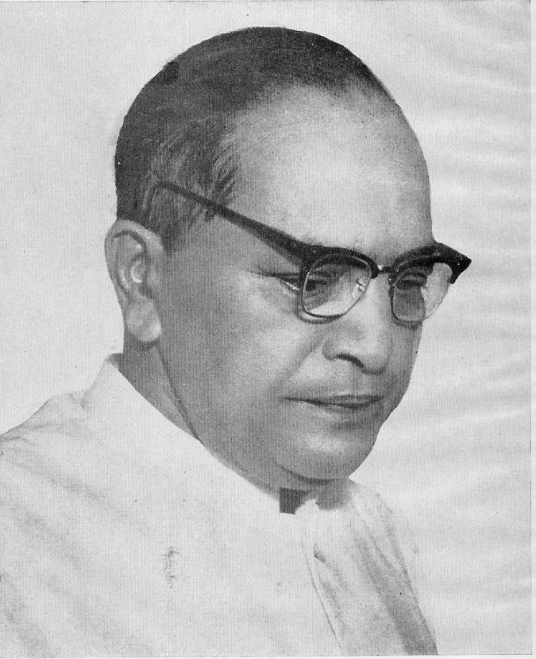
Dr. Bhimrao Ramji Ambedkar
Dr. Ambedkar wrote the Constitution of India

Slide 4
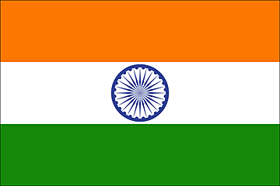
How we celebrate Republic day National Flag is hoisted
Courage, Sacrifice
Truth, Purity
Faith, Growth, Prosperity
The chakra diameter approximates the width of the white band and it has 24 spokes, which intends to show that there is life in movement and death in stagnation . Chakra represents: Progress & Laws of Dharma (righteousness)
The saffron stands for courage, sacrifice and the spirit of renunciation; the white, for purity and truth; the green for faith, growth and prosperity.

Slide 5
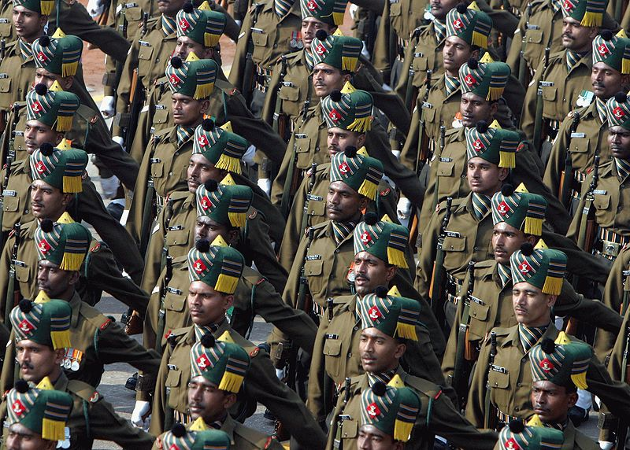
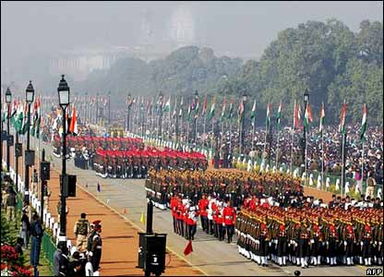
Republic day parade

Slide 6
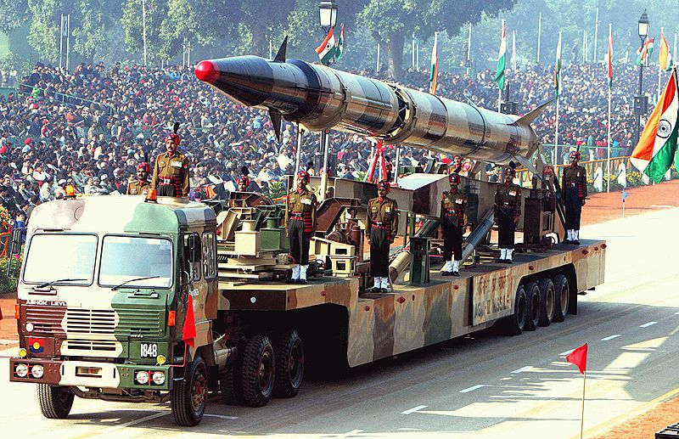
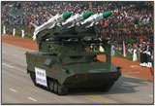
Army, Navy and Airforce participate

Slide 7
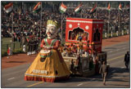
School children participate in parade

Slide 8
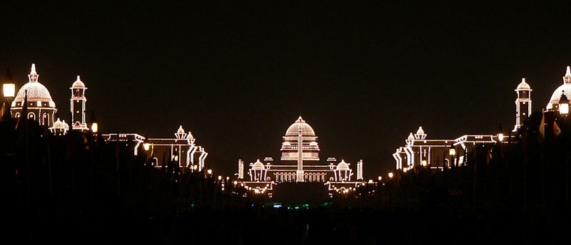
Rashtrapati Bhavan is Decorated

Slide 9
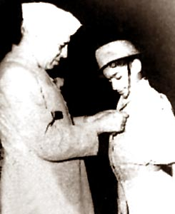
National Bravery award for Indian children
The award is given to around 24 children below the age of 16. One of two coveted awards in this category are the Sanjay Chopra Award and Geeta Chopra Award instituted in 1978, in the memory of Chopra children who laid their lives while confronting their kidnappers, and are given to a boy and a girl respectively for acts of bravery . The highest award in the category is the Bharat Award, constituted in 1987, and the Bapu Gayadhani Award was instituted in 1988.

Slide 10
Indian National Anthem written by Rabindranath Tagore
Jana-gana-mana-adhinayaka, jaya he
Bharata-bhagya-vidhata.
Punjab-Sindh-Gujarat-Maratha
Dravida-Utkala-Banga
Vindhya-Himachala-Yamuna-Ganga
Uchchala-Jaladhi-taranga.
Tava shubha name jage,
Tava shubha asisa mage,
Gahe tava jaya gatha,
Jana-gana-mangala-dayaka jaya he
Bharata-bhagya-vidhata.
Jaya he, jaya he, jaya he,
Jaya jaya jaya, jaya he!

Slide 11
National Symbols of India
National Animal : Tiger
National Bird: Peacock
National Flower: Lotus
National Fruit: Mango
National Tree: Indian fig tree, Ficus bengalensis, banyan tree
National River: Ganges
National Aquatic animal: River Dolphin

